Slide 1


Sarvajanik Education Society
Sarvajanik College of Engineering & Technology, Surat.
Master of Computer Applications
Academic Year: 2024– 25
A PROJECT ON
Pam Boutique
Presented By:
Parmar Hetvani (ET23MTCA037)
Girase Pradipsing (ET23MTCA086)
MCA II SEM-4
Under the Guidance of
Prof. Margee Rawal

Slide 2
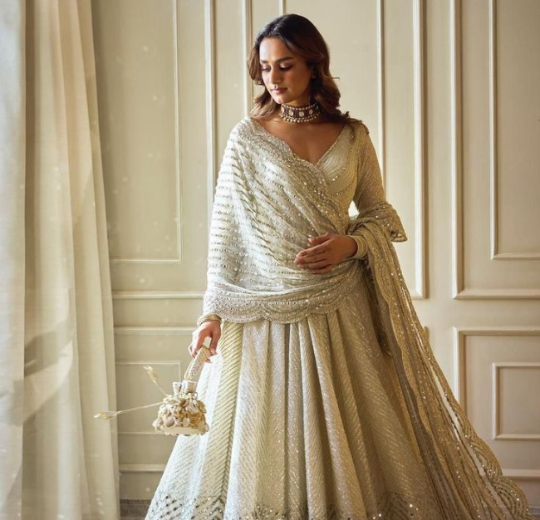
pam
Boutique

Slide 3

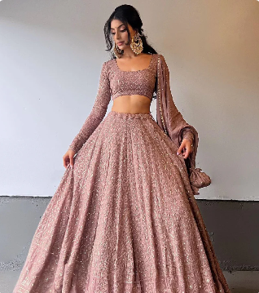
AGENDA
Project Abstract
Objective
Software Specificaions
Database Design
Advantages
Limitations
Screenshots
References

Slide 4


abstract
Our Pam Boutique Website is designed to provide a modern and seamless shopping experience for customers looking for Chaniya Choli and Ethnic Wear.
The platform offers a diverse collection of high-quality traditional outfits, combining cultural heritage with contemporary fashion trends.
A user-friendly interface ensures smooth navigation and effortless browsing.
Customers can refine their search using advanced filtering options and enjoy a secure shopping experience with a robust payment gateway.
The backend, built with Node.js and SQL, ensures efficient data management and fast, secure transactions.
The frontend, developed using React.js, provides a responsive and interactive UI for seamless accessibility across all devices.
Our aim is not just to sell clothing but to bring Indian cultural fashion to the digital world, making it more accessible to a global audience.

Slide 5
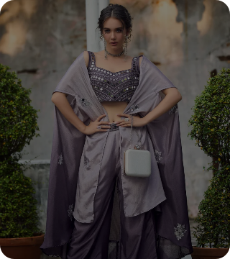
OBJECTIVE
Provide a seamless online shopping experience for traditional clothing enthusiasts.
Promote Indian ethnic wear by offering a vast collection of Chaniya Choli and other traditional outfits.
Ensure a secure and hassle-free shopping process with easy navigation, filtering options, and a strong payment security system.
Develop a responsive and scalable platform using React.js, Node.js, and SQL for smooth performance and efficient backend management.
Enable customization options, such as stitching preferences, to enhance the shopping experience.
Expand the reach of traditional fashion by making high-quality ethnic wear accessible to customers worldwide.

Slide 6
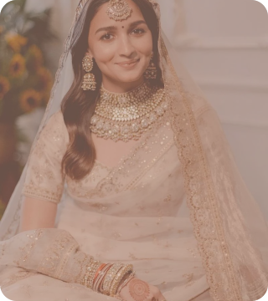
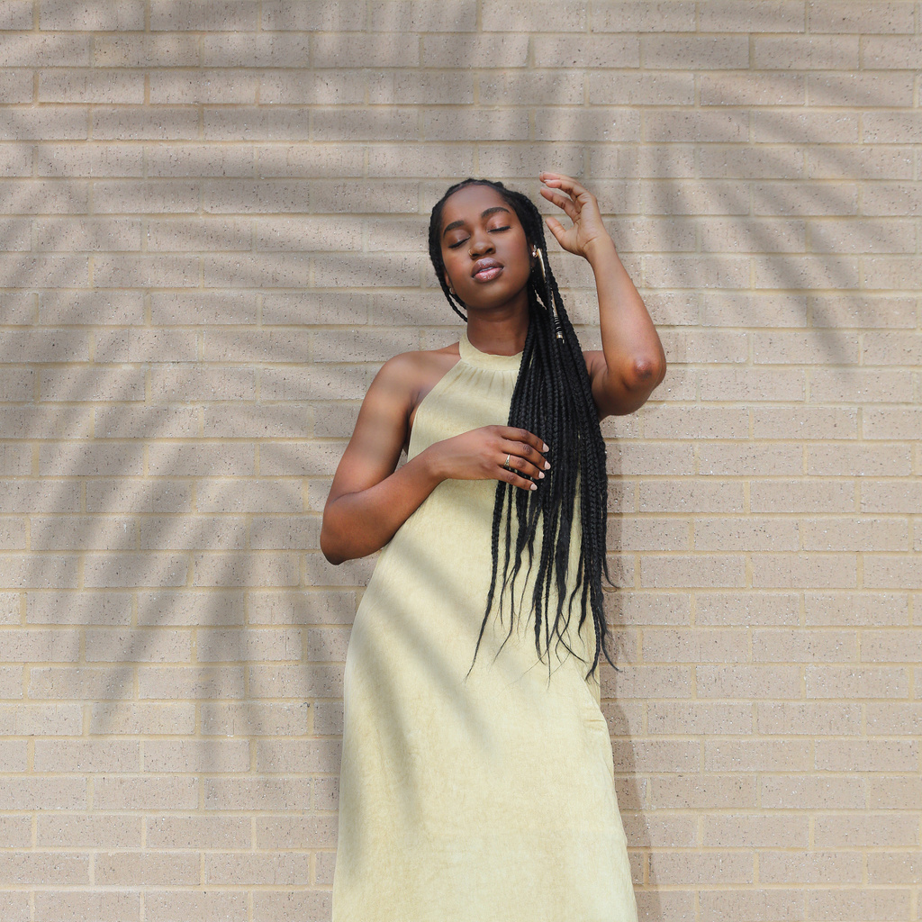

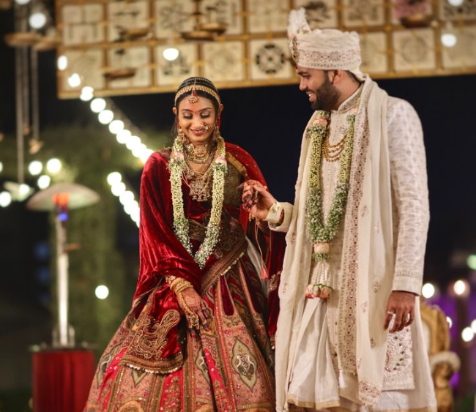
Software Specification
Project Profile | Palm Boutique
Organization | Godhani Technologie Pvt. Ltd.
Tech Stack | Reactjs and Nodejs
Database | SQL
Submitted To | Sarvajanik College Of Engineering And Technology
Presented By | Parmar Hetvani , Girase Pradipsing

Slide 7

Database design
Usecase Diagram
Sequence Diagram
Activity Diagram

Slide 8
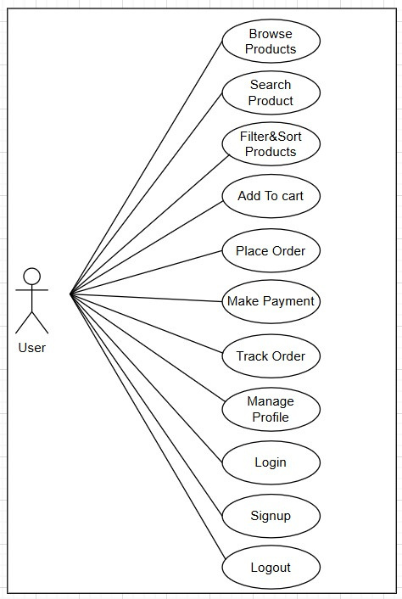
Use Case Diagram
USER:

Slide 9
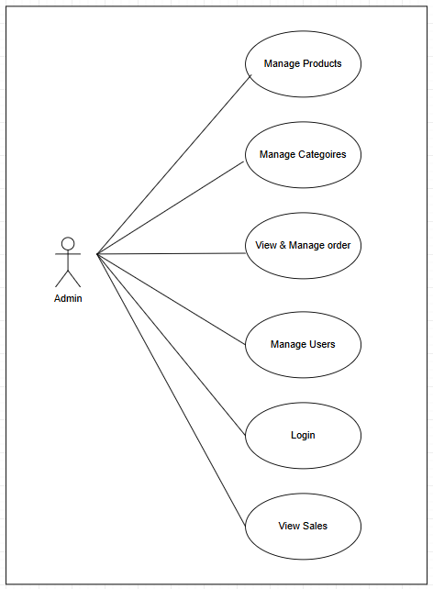
ADMIN:

Slide 10
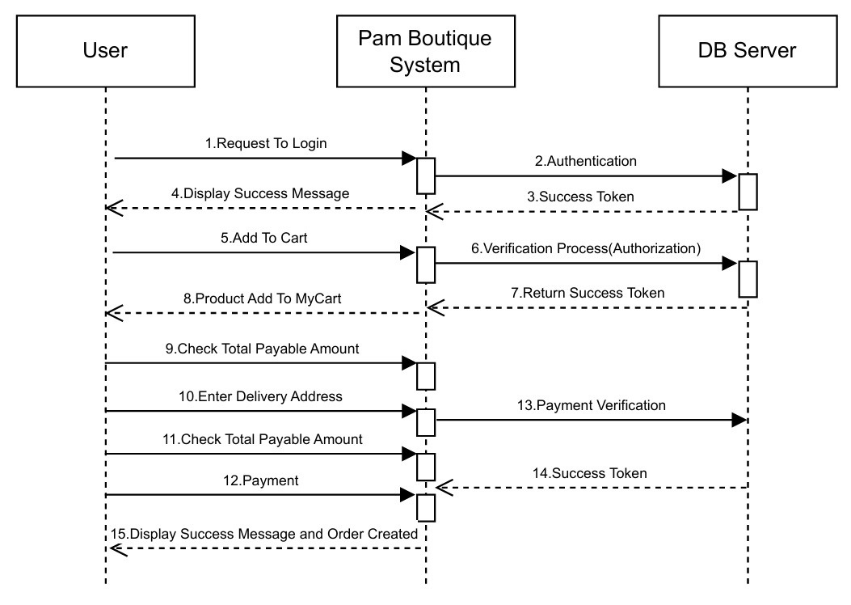
SEQUENCE DIAGRAM:
USER:

Slide 11
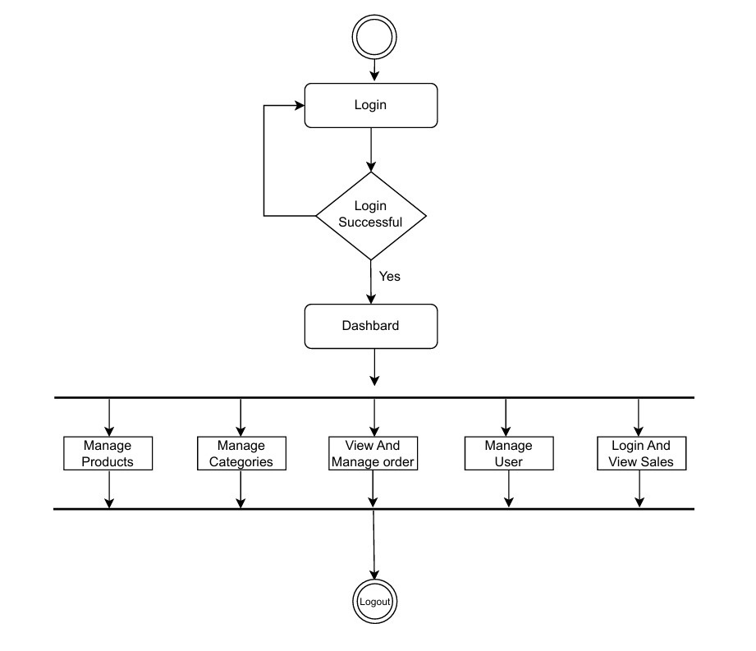
ACTIVITY DIAGRAM:
ADMIN

Slide 12

Advantage
Wide Product Availability – Customers can explore a diverse collection of Chaniya Choli and Ethnic Wear from different styles and regions.
Advanced Filtering & Search – Customers can easily find products based on color, size, price range, fabric, and other attributes.
Secure Transactions – A robust payment gateway ensures safe and smooth online payments.
Customization Options – Features like stitching preferences enhance the user experience.
Mobile-Friendly Design – A responsive UI ensures a seamless experience across desktops, tablets, and smartphones.
Scalability & Performance – Built using React.js, Node.js, and SQL, the website can handle high traffic efficiently.

Slide 13
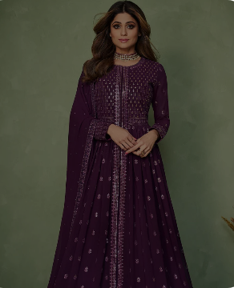

limitations
Lack of Physical Try-On – Customers cannot physically try the products before purchasing, which may lead to returns and exchanges.
Shipping & Delivery Delays – Logistics issues may cause delays, especially in remote areas.
Customer Trust Issues – New brands often struggle to gain customer trust, especially if they lack reviews and testimonials.
Dependency on Internet Connectivity – Customers need stable internet access to browse and shop, which may be a limitation in rural areas.
Handling Customer Queries – Without an efficient customer support system, managing complaints and queries can be difficult.

Slide 14
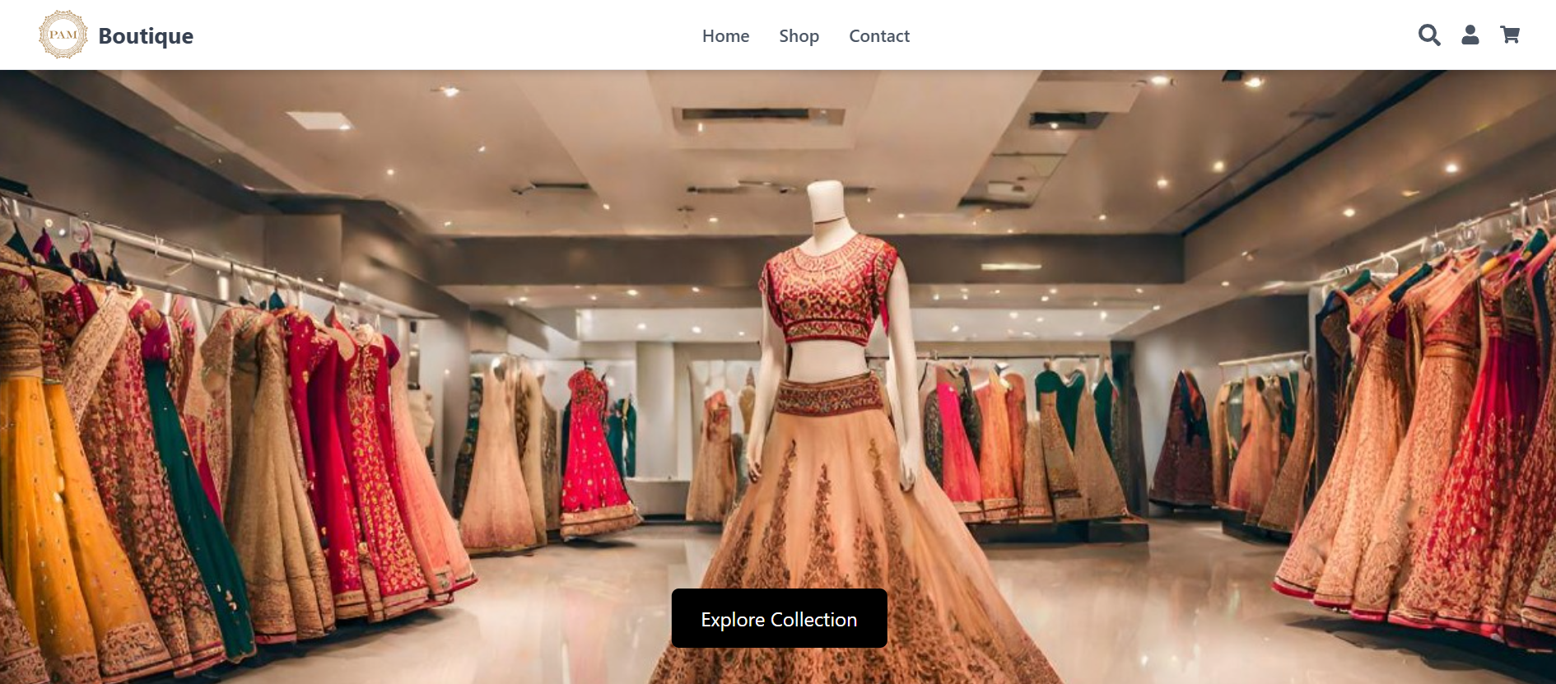
screenshots
Home Page

Slide 15
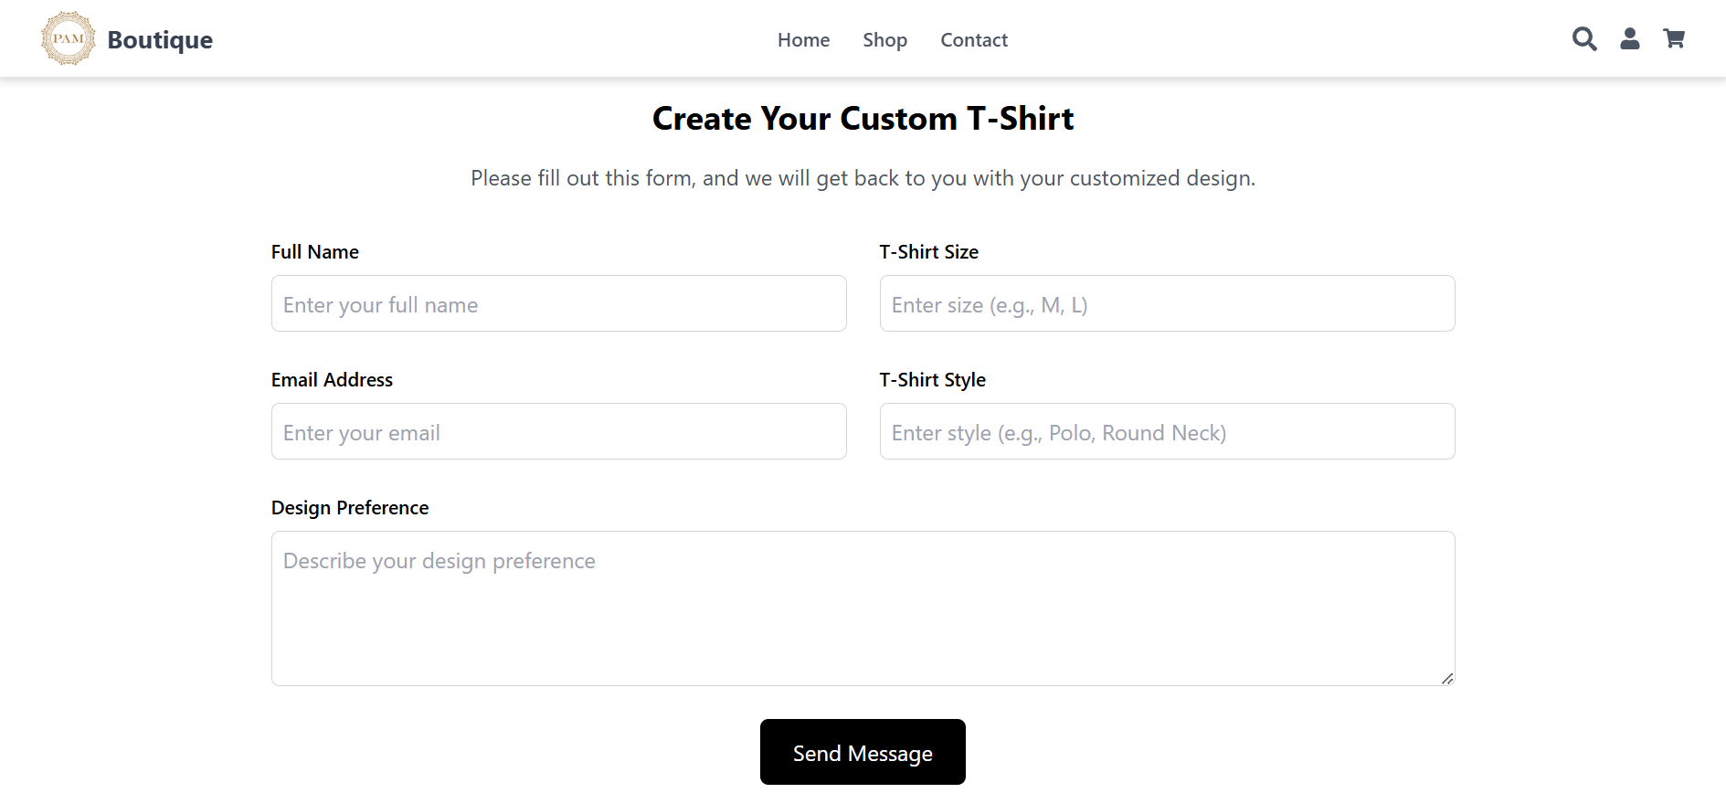
Contact Us Page

Slide 16
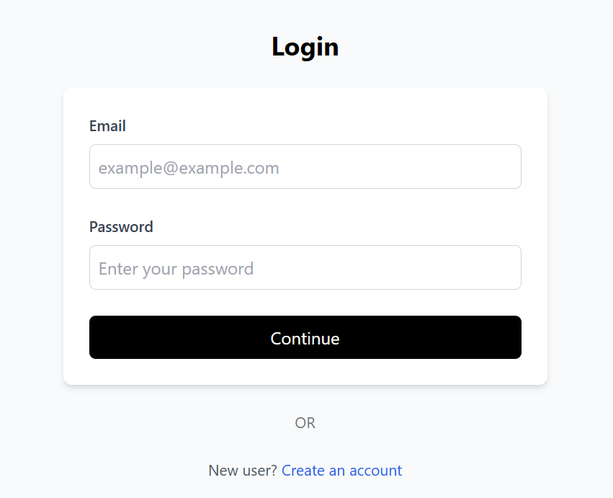
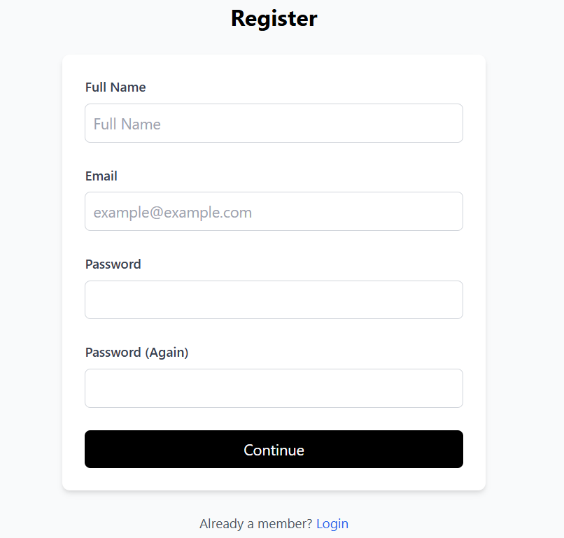
Login And Signup

Slide 17
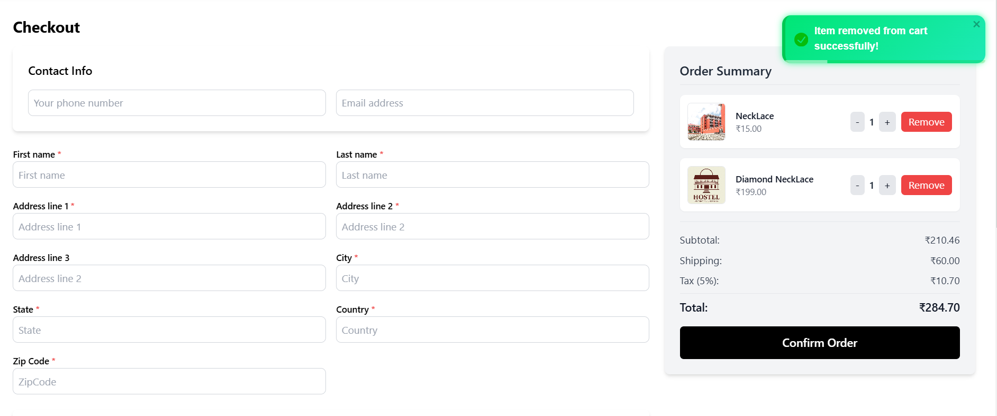
Cart And Checkout Page

Slide 18
thank you

